Slide 1

Organizational Change and Stress Management
© 2009 Prentice-Hall Inc. All rights reserved.
19-<number>

Slide 2
Chapter Learning Objectives
After studying this chapter, you should be able to:
  Identify forces that act as stimulants to change, and contrast planned and unplanned change.
  List the forces for resistance to change.
  Compare the four main approaches to managing organizational change.
  Demonstrate two ways of creating a culture for change.
  Define stress and identify its potential sources.
  Identify the consequences of stress.
  Contrast the individual and organizational approaches to managing stress.
  Explain global differences in organizational change and work stress.
© 2009 Prentice-Hall Inc. All rights reserved.
19-<number>

Slide 3

Forces for Change
Nature of the Workforce
  Greater diversity
Technology
  Faster, cheaper, more mobile
Economic Shocks
  Mortgage meltdown
Competition
  Global marketplace
Social Trends
  Baby boom retirements
World Politics
  Iraq War and the opening of China
E X H I B I T 19-1
© 2009 Prentice-Hall Inc. All rights reserved.
19-<number>

Slide 4
Planned Change
Change
  Making things different
Planned Change
  Activities that are proactive and purposeful: an intentional, goal-oriented activity
  Goals of planned change
    Improving the ability of the organization to adapt to changes in its environment
    Changing employee behavior
Change Agents
  Persons who act as catalysts and assume the responsibility for managing change activities
© 2009 Prentice-Hall Inc. All rights reserved.
19-<number>

Slide 5
Resistance to Change
Resistance to change appears to be a natural and positive state
Forms of Resistance to Change:
  Overt and Immediate
    Voicing complaints, engaging in job actions
  Implicit and Deferred
    Loss of employee loyalty and motivation, increased errors or mistakes, increased absenteeism
    Deferred resistance clouds the link between source and reaction
© 2009 Prentice-Hall Inc. All rights reserved.
19-<number>

Slide 6
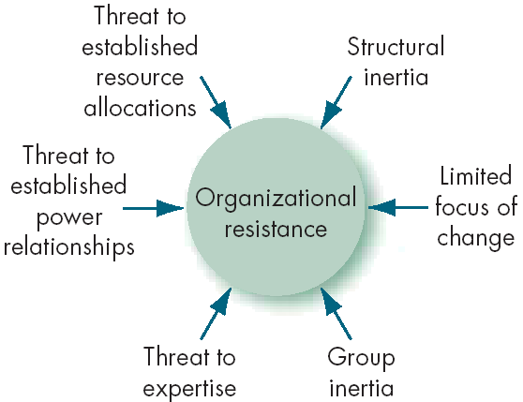
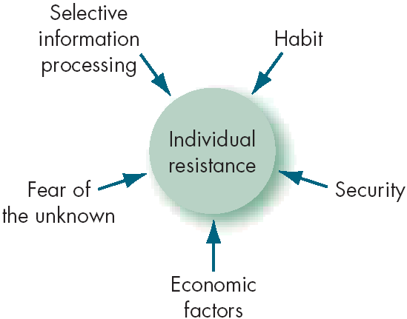
Sources of Resistance to Change
E X H I B I T 19-2
© 2009 Prentice-Hall Inc. All rights reserved.
19-<number>

Slide 7
Tactics for Overcoming Resistance to Change
Education and Communication
  Show those effected the logic behind the change
Participation
  Participation in the decision process lessens resistance
Building Support and Commitment
  Counseling, therapy, or new-skills training
Implementing Change Fairly
  Be consistent and procedurally fair
Manipulation and Cooptation
  “Spinning” the message to gain cooperation
Selecting people who accept change
  Hire people who enjoy change in the first place
Coercion
  Direct threats and force
© 2009 Prentice-Hall Inc. All rights reserved.
19-<number>

Slide 8

The Politics of Change
Impetus for change is likely to come from outside change agents, new employees, or managers outside the main power structure.
Internal change agents are most threatened by their loss of status in the organization.
Long-time power holders tend to implement incremental but not radical change.
The outcomes of power struggles in the organization will determine the speed and quality of change.
© 2009 Prentice-Hall Inc. All rights reserved.
19-<number>

Slide 9
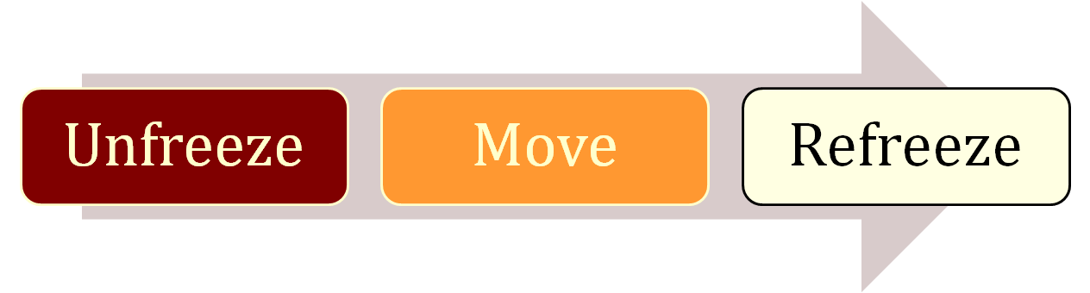
Lewin’s Three-Step Change Model
Unfreezing
  Change efforts to overcome the pressures of both individual resistance and group conformity
Refreezing
  Stabilizing a change intervention by balancing driving and restraining forces
E X H I B I T 19-3
© 2009 Prentice-Hall Inc. All rights reserved.
19-<number>

Slide 10
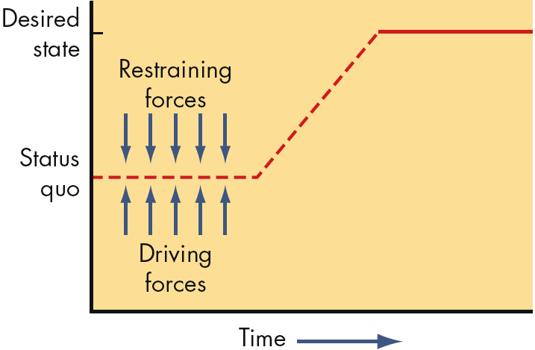
Lewin: Unfreezing the Status Quo
Driving Forces
  Forces that direct behavior away from the status quo
Restraining Forces
  Forces that hinder movement from the existing equilibrium
E X H I B I T 19-4
© 2009 Prentice-Hall Inc. All rights reserved.
19-<number>

Slide 11
Kotter’s Eight-Step Plan
Builds from Lewin’s Model
To implement change:
  Establish a sense of urgency
  Form a coalition
  Create a new vision
  Communicate the vision
  Empower others by removing barriers
  Create and reward short-term “wins”
  Consolidate, reassess, and adjust
  Reinforce the changes
Unfreezing
Movement
Refreezing
E X H I B I T 19-5
© 2009 Prentice-Hall Inc. All rights reserved.
19-<number>

Slide 12

Action Research
  A change process based on systematic collection of data and then selection of a change action based on what the analyzed data indicates
Process steps:
  Diagnosis
  Analysis
  Feedback
  Action
  Evaluation
Action research benefits:
  Problem-focused rather than solution-centered
  Heavy employee involvement reduces resistance to change
© 2009 Prentice-Hall Inc. All rights reserved.
19-<number>

Slide 13

Organizational Development
Organizational Development (OD)
  A collection of planned interventions, built on humanistic-democratic values, that seeks to improve organizational effectiveness and employee well-being
OD Values
  Respect for people
  Trust and support
  Power equalization
  Confrontation
  Participation
© 2009 Prentice-Hall Inc. All rights reserved.
19-<number>

Slide 14
Six OD Techniques
Sensitivity Training
  Training groups (T-groups) that seek to change behavior through unstructured group interaction
  Provides increased awareness of others and self
  Increases empathy with others, listening skills, openness, and tolerance for others
Survey Feedback Approach
  The use of questionnaires to identify discrepancies among member perceptions; discussion follows and remedies are suggested
Process Consultation (PC)
  A consultant gives a client insights into what is going on around the client, within the client, and between the client and other people; identifies processes that need improvement.
© 2009 Prentice-Hall Inc. All rights reserved.
19-<number>

Slide 15
Six OD Techniques (Continued)
Team Building
  High interaction among team members to increase trust and openness
Intergroup Development
  OD efforts to change the attitudes, stereotypes, and perceptions that groups have of each other
Appreciative Inquiry
  Seeks to identify the unique qualities and special strengths of an organization, which can then be built on to improve performance
    Discovery: Recalling the strengths of the organization
    Dreaming: Speculation on the future of the organization
    Design: Finding a common vision
    Destiny: Deciding how to fulfill the dream
© 2009 Prentice-Hall Inc. All rights reserved.
19-<number>

Slide 16
Creating a Culture for Change: Innovation
Stimulating a Culture of Innovation
  Innovation: a new idea applied to initiating or improving a product, process, or service
  Sources of Innovation:
    Structural variables: organic structures
    Long-tenured management
    Slack resources
    Interunit communication
  Idea Champions: Individuals who actively promote the innovation
© 2009 Prentice-Hall Inc. All rights reserved.
19-<number>

Slide 17
Creating a Culture for Change: Learning
Learning Organization
  An organization that has developed the continuous capacity to adapt and change
  Learning Types
    Single-Loop: errors are corrected using past routines
    Double-Loop: errors are corrected by modifying routines
  Characteristics
    Holds a shared vision
    Discards old ways of thinking
    Views organization as system of relationships
    Communicates openly
    Works together to achieve shared vision
E X H I B I T 19-6
© 2009 Prentice-Hall Inc. All rights reserved.
19-<number>

Slide 18
Creating a Learning Organization
Overcomes traditional organization problems:
  Fragmentation
  Competition
  Reactiveness
Manage Learning by:
  Establishing a strategy
  Redesigning the organization’s structure
    Flatten structure and increase cross-functional activities
  Reshaping the organization’s culture
    Reward risk-taking and intelligent mistakes
© 2009 Prentice-Hall Inc. All rights reserved.
19-<number>

Slide 19
Work Stress
Stress
  A dynamic condition in which an individual is confronted with an opportunity, constraint, or demand related to what he or she desires and for which the outcome is perceived to be both uncertain and important
Types of Stress
  Challenge Stressors
    Stress associated with workload, pressure to complete tasks, and time urgency
  Hindrance Stressors
    Stress that keeps you from reaching your goals, such as red tape
    Cause greater harm than challenge stressors
E X H I B I T 19-7
© 2009 Prentice-Hall Inc. All rights reserved.
19-<number>

Slide 20
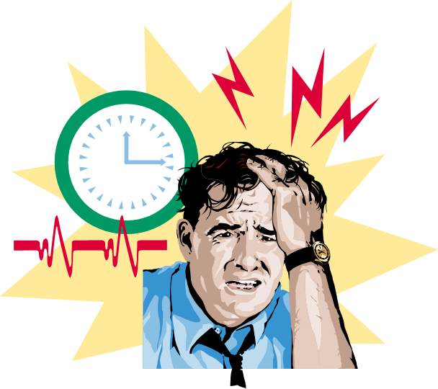
Demands-Resources Model of Stress
Demands
  Responsibilities, pressures, obligations, and uncertainties in the workplace
Resources
  Things within an individual’s control that can be used to resolve demands
Adequate resources help reduce the stressful nature of demands
© 2009 Prentice-Hall Inc. All rights reserved.
19-<number>

Slide 21
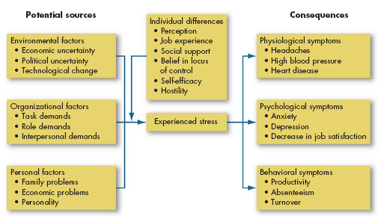
A Model of Stress
E X H I B I T 19-8
© 2009 Prentice-Hall Inc. All rights reserved.
19-<number>

Slide 22
Potential Sources of Stress
Environmental Factors
  Economic uncertainties of the business cycle
  Political uncertainties of political systems
  Technological uncertainties of technical innovations
Organizational Factors
  Task demands related to the job
  Role demands of functioning in an organization
  Interpersonal demands created by other employees
Personal Factors
  Family and personal relationships
  Economic problems from exceeding earning capacity
  Personality problems arising from basic disposition
© 2009 Prentice-Hall Inc. All rights reserved.
19-<number>

Slide 23
Consequences of Stress
Stressors are additive: high levels of stress can lead to the following symptoms
  Physiological
    Blood pressure, headaches, stroke
  Psychological
    Dissatisfaction, tension, anxiety, irritability, boredom, and procrastination
    Greatest when roles are unclear in the presence of conflicting demands
  Behavioral
    Changes in job behaviors, increased smoking or drinking, different eating habits, rapid speech, fidgeting, sleep disorders
© 2009 Prentice-Hall Inc. All rights reserved.
19-<number>

Slide 24
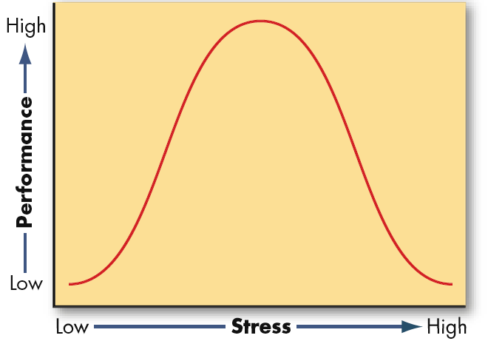
Not All Stress Is Bad
Some level of stress can increase productivity
Too little or too much stress will reduce performance
This model is not empirically supported
E X H I B I T 19-9
© 2009 Prentice-Hall Inc. All rights reserved.
19-<number>

Slide 25

Managing Stress
Individual Approaches
  Implementing time management
  Increasing physical exercise
  Relaxation training
  Expanding social support network
Organizational Approaches
  Improved personnel selection and job placement
  Training
  Use of realistic goal setting
  Redesigning of jobs
  Increased employee involvement
  Improved organizational communication
  Offering employee sabbaticals
  Establishment of corporate wellness programs
© 2009 Prentice-Hall Inc. All rights reserved.
19-<number>

Slide 26

Global Implications
Organizational Change
  Culture varies people’s belief in the possibility of change
  Time orientation will affect implementation of change
  Reliance on tradition can increase resistance to change
  Power distance can modify implementation methods
  Idea champions act differently in different cultures
Stress
  Job conditions that cause stress vary across cultures
  Stress itself is bad for everyone
  Having friends and family can reduce stress
© 2009 Prentice-Hall Inc. All rights reserved.
19-<number>

Slide 27
Summary and Managerial Implications
Organizations and the individuals within them must undergo dynamic change
Managers are change agents and modifiers of organizational culture
Stress can be good or bad for employees
Despite possible improvements in job performance caused by stress, such improvements come at the cost of increased job dissatisfaction
© 2009 Prentice-Hall Inc. All rights reserved.
19-<number>

Slide 28

All rights reserved. No part of this publication may be reproduced, stored in a retrieval system, or transmitted, in any form or by any means, electronic, mechanical, photocopying, recording, or otherwise, without the prior written permission of the publisher. Printed in the United States of America.
Copyright ©2009 Pearson Education, Inc. Publishing as Prentice Hall

